Slide 1

SJF – Shortest Job First
Group No 01
CO 2112

Slide 2
Content
Introduction
Algorithm
Real World Scenario
Pros
Cons
Comparison

Slide 3
SJF
SJF, Short Job First is an algorithm that is used in CPU scheduling.
In this, the process with the lowest burst time, among the list of available processes in the ready queue, is going to be scheduled next.
This algorithm is used significantly to optimize the processing speed of the processors.

Slide 4
Algorithm
Start with sorting all the processes based on their time of arrival at the processor.
Then select the earliest arriving process with the shortest burst time.
While executing the current process, all the waiting processes are pushed into the waiting queue, and when the current process ends, choose the process with the shortest burst time among the waiting processes.

Slide 5
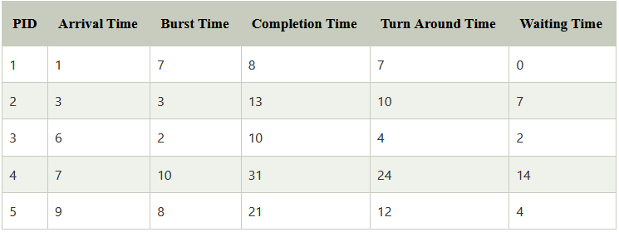
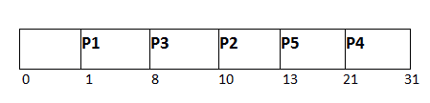
Example

Slide 6

Real World Scenario
Online delivery apps
always choose to deliver the nearest order first, then after delivering the first order, it searches for the next nearest delivery location.

Slide 7
Pros
SJF is frequently used for long-term scheduling.
It reduces the average waiting time over FIFO (First in First Out) algorithm.
SJF method gives the lowest average waiting time for a specific set of processes.
It is appropriate for the jobs running in batch, where run times are known in advance.
For the batch system of long-term scheduling, a burst time estimate can be obtained from the job description.
For Short-Term Scheduling, we need to predict the value of the next burst time.
Probably optimal with regard to average turnaround time.

Slide 8
Cons
Job completion time must be known earlier, but it is hard to predict.
It is often used in a batch system for long term scheduling.
SJF can’t be implemented for CPU scheduling for the short term. It is because there is no specific method to predict the length of the upcoming CPU burst.
This algorithm may cause very long turnaround times or starvation.
Requires knowledge of how long a process or job will run.
It leads to the starvation that does not reduce average turnaround time.
It is hard to know the length of the upcoming CPU request.
Elapsed time should be recorded, that results in more overhead on the processor.

Slide 9
It’s Time to Compare SJF with Others

Slide 10
FCFS Vs. SJF
FCFS | SJF
Executes the processes in the order in which they arrive i.e. the process that arrives first is executed first. | Executes the processes based upon their burst time i.e. in ascending order of their burst times.
FCFS results in quite long waiting time for the processes and thus increases average waiting time. | The average waiting time for given set of processes is minimum.
FCFS algorithm is the easiest to implement in any system. | The real difficulty with SJF is knowing the length of the next CPU request or burst.
FCFS lead to lower device and CPU utilization thereby decreasing the efficiency of the system. | SJF leads to higher effectiveness of the system due to lower average waiting time.
FCFS results in minimal overhead. | In case of SJF, elapsed time should be recorded, results in more overhead on the processor.
FCFS does not suffers from starvation | SJF suffers from starvation.

Slide 11
Priority Scheduling Vs. SJF
SJF | Priority Scheduling
Executes the processes based upon their burst time i.e. in ascending order of their burst times. | Executes the processes based upon their priorities i.e. in descending order of their priorities. A process with higher priority is executed first.
The average waiting time for given set of processes is minimum. | There is no idea of average waiting time and response time.
The real difficulty with SJF is knowing the length of the next CPU request or burst. | It is quite easy to implement and best for real time operating systems.
SJF is also non-preemptive but its preemptive version is also there called Shortest Remaining Time First (SRTF) algorithm. | Priority scheduling is both preemptive and non preemptive in nature.
A long process may never get executed and the system may keep executing the short processes. | The problem of blocking of a process can be solved through aging which means to gradually increase the priority of a process after a fixed interval of time by a fixed number.

Slide 12
RR VS. SJF
Round-Robin (RR) | SJF
Executes the processes based on the time quantum defined. i.e. each process is executed for a fixed amount of time. | Executes the processes based upon their burst time i.e. in ascending order of their burst times.
The average waiting time for given set of processes is quite small and depends on the time quantum. | The average waiting time for given set of processes is minimum.
It is quite easy to implement RR. | The real difficulty with SJF is knowing the length of the next CPU request or burst.
Each process is executed and every user feels that his work is being done as the CPU gives equal amount of time to each process. | A long process may never get executed and the system may keep executing the short processes.
In case of RR, if the time quantum is very small then context switch takes place again and again after very short intervals of time which leads to overhead. | In case of SJF, elapsed time should be recorded, results in more overhead on the processor.

Slide 13
Group Members
EUSL/TC/IS/201/COM/01
EUSL/TC/IS/201/COM/13
EUSL/TC/IS/201/COM/21
EUSL/TC/IS/201/COM/42
EUSL/TC/IS/201/COM/50
EUSL/TC/IS/201/COM/66
EUSL/TC/IS/201/COM/80
EUSL/TC/IS/201/COM/95
EUSL/TC/IS/201/COM/102

Slide 14
Thank You!

